Slide 1
CUDA 5 Sparse Matrix-Vector Multiplication
CS121 Parallel Computing
Spring 2021

Slide 2
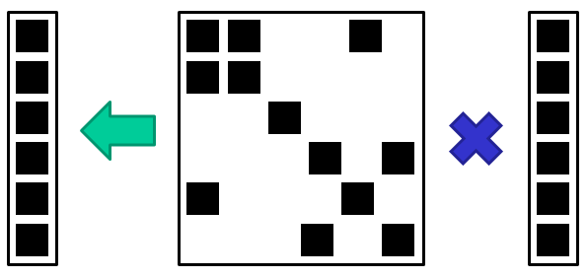
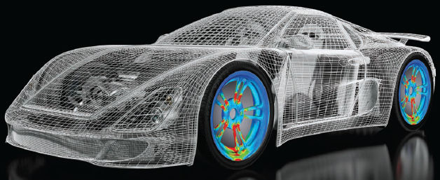
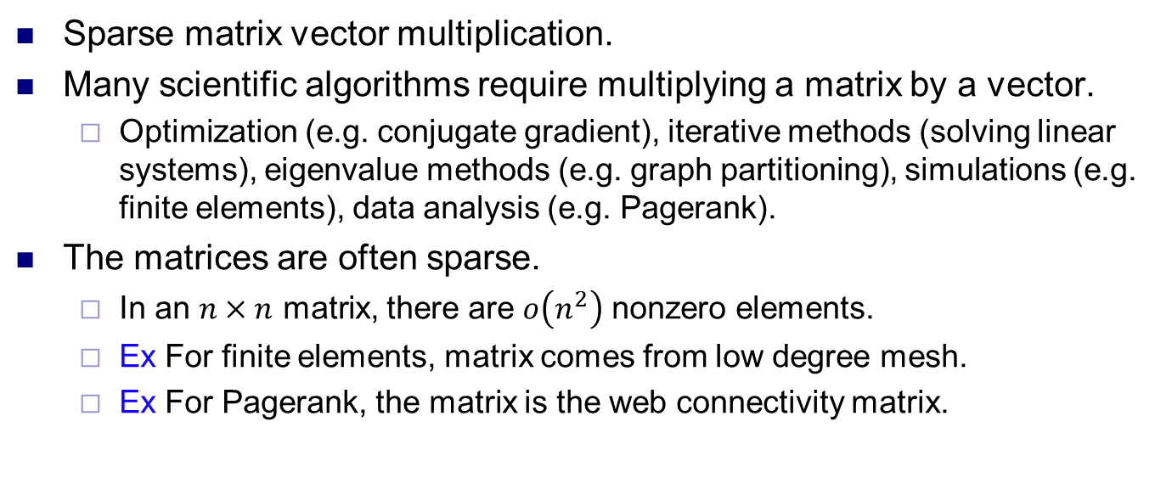
SpMV
Sparse matrix vector multiplication.
Many scientific algorithms require multiplying a matrix by a vector.
Optimization (e.g. conjugate gradient), iterative methods (solving linear systems), eigenvalue methods (e.g. graph partitioning), simulations (e.g. finite elements), data analysis (e.g. Pagerank).
The matrices are often sparse.
In an $n×n$ matrix, there are $o\left(n^{2}\right)$ nonzero elements.
Ex For finite elements, matrix comes from low degree mesh.
Ex For Pagerank, the matrix is the web connectivity matrix.

Slide 3
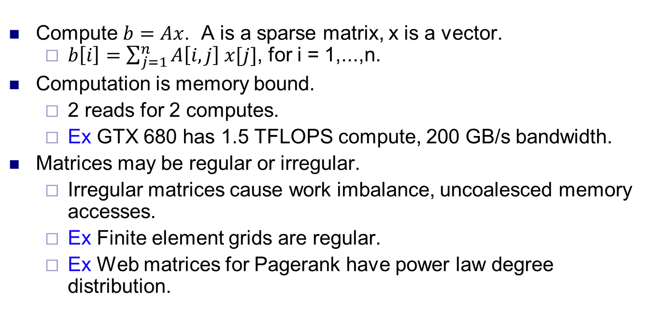
SpMV challenges
Compute $b=Ax$. A is a sparse matrix, x is a vector.
$b\left[i\right]=\sum_{j=1}^{n}{A\left[i,j\right] x[j]}$, for i = 1,...,n.
Computation is memory bound.
2 reads for 2 computes.
Ex GTX 680 has 1.5 TFLOPS compute, 200 GB/s bandwidth.
Matrices may be regular or irregular.
Irregular matrices cause work imbalance, uncoalesced memory accesses.
Ex Finite element grids are regular.
Ex Web matrices for Pagerank have power law degree distribution.

Slide 4
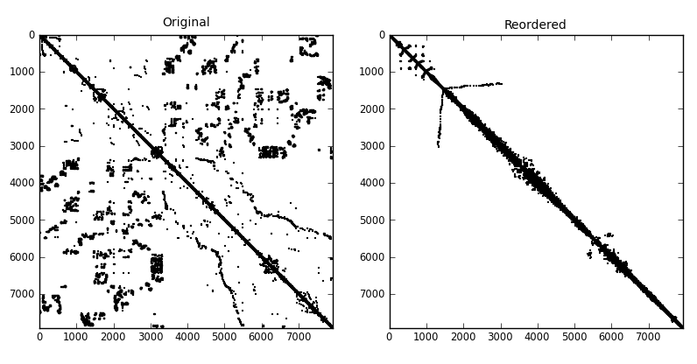
SpMV techniques
Matrix and vector both stored in global memory.
Nothing we can do about memory boundedness.
Unlike matrix-matrix multiply, few values are read multiple times.
To address irregularity of matrix accesses
Store only the nonzero matrix elements.
Different matrix storage formats improve memory coalescing.
Formats also improve load balancing.
Assign threads to work to minimize divergence.
To regularize vector accesses, permute elements to make matrix more block diagonal and cache vector elements.
Expensive, but done once per matrix and can be reused.

Slide 5
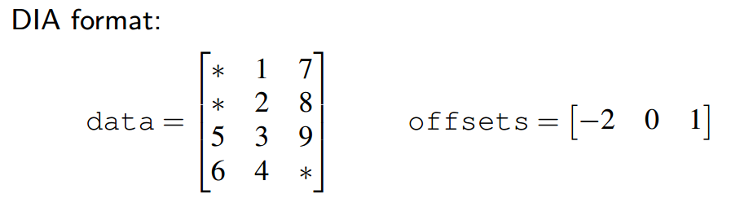
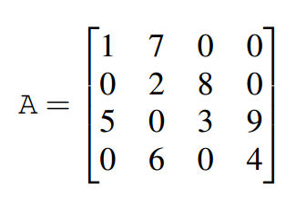
DIA format
Look at values along the diagonal of the matrix.
Data stored in column major form.
Column i contains values on i’th nonzero diagonal.
* indicates no value at location.
offsets[i] stores offset of i’th diagonal from main diagonal.
-i means i diagonals to left, +i means i diagonals to right.
Only effective for matrices where nonzeros lie on a few diagonals.
Stencils, grids, finite element meshes.

Slide 6
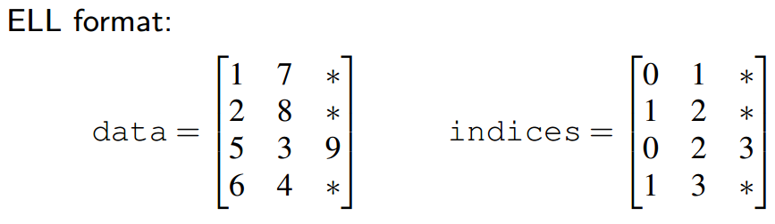
ELL format
data and indices have one row for each row of A.
data[i,j] is value of j’th nonzero in i’th row of A.
If no j’th nonzero, store padding value *.
indices[i,j] is column of j’th nonzero in i’th row of A.
Number of columns in data and indices equals maximum number of nonzeros in any row of A.
Store data and indices in column major format.
Efficient only for matrices with roughly same number of columns per row.

Slide 7
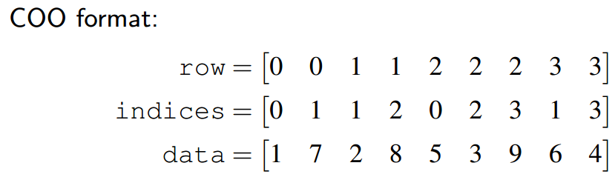
COO format
Store coordinates of all nonzeros in A in row major form.
i’th element in row[i], column indices[i], has value data[i].
Most general purpose format. Matrix can be any shape.
Somewhat inefficient, as it repeatedly stores row index of elements in same row.
Uses more global memory to store.
Causes more global memory traffic when reading matrix.

Slide 8
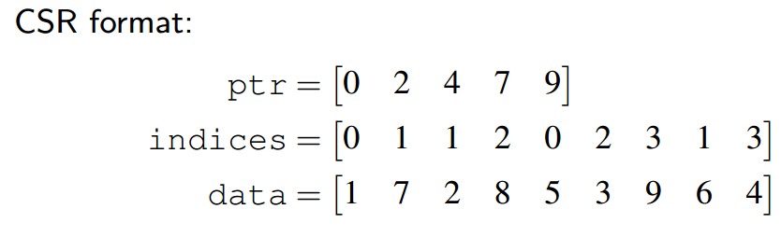
CSR format
Compressed sparse row.
Like COO, but don’t repeat row indices.
ptr has n elements, one for each row.
ptr[i] is the index in indices where i’th row starts.
Elements in i’th row have indices between ptr[i] and ptr[i+1]-1.
Column of j’th element in i’th row is indices[ptr[i]+j].
Value of j’th element in i’th row is data[ptr[i]+j].
Flexible, efficient, widely used format.

Slide 9
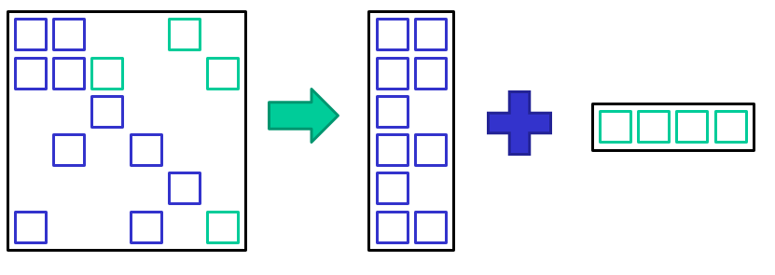
Hybrid format
A combination of ELL and COO.
Assumes most rows have similar length L.
Break A into two matrices, one containing first L nonzeros of each row of A, other containing remaining elements.
Store first matrix using ELL, other using COO.
Another flexible, efficient format.

Slide 10
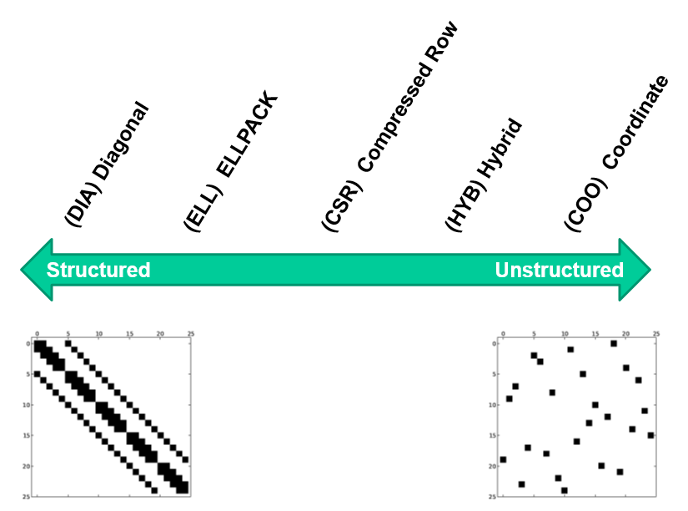
Which kernel to use?
Right kernel depends on structure of matrix.

Slide 11
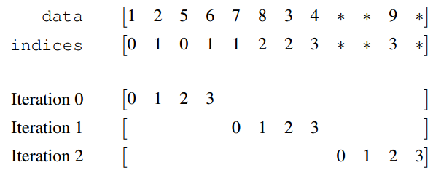
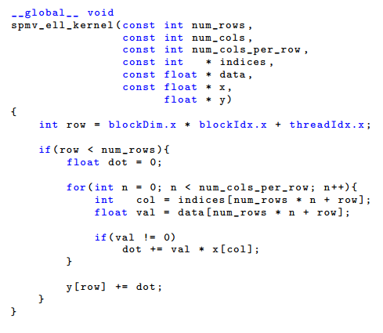
ELL kernel
Assign i’th thread to read i’th row of data and indices.
If all rows have similar lengths, get good load balancing.
Each thread takes about same number of steps to finish.
Since data, indices stored in column major format, all memory accesses coalesced.
Use indices to read coordinates of vector and perform dot product.

Slide 12
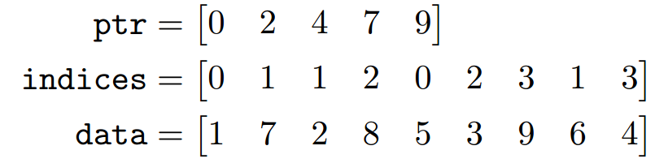
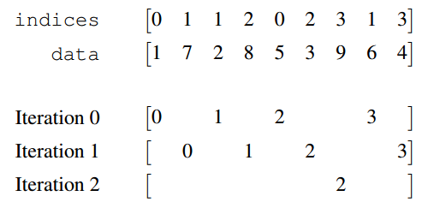
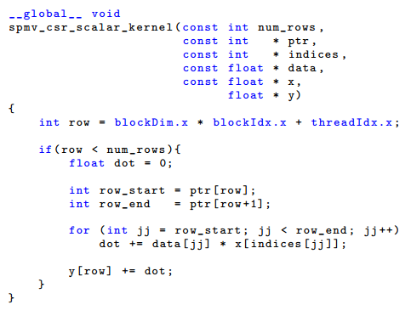
CSR scalar kernel
Assign one thread per row.
Not load balanced, since rows can be different lengths.
Rarely memory coalesced, since elements of different rows likely stored far apart.
Usually poor performance.

Slide 13
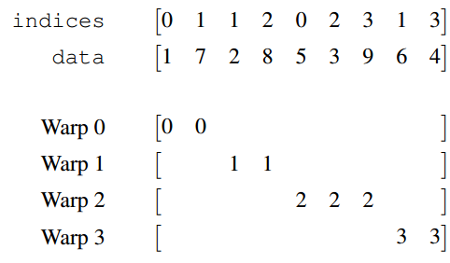
CSR vector kernel
Assign one warp per row.
Thread i in warp reads elements i, i+32, i+64, ...
Better memory coalescing.
Some threads in warp idle if row length too small or not divisible by 32.
Different warps not load balanced if rows have different lengths.
But inter-warp imbalance less serious than intra-warp imbalance, since SM scheduler can switch between warps.
This still hides memory latency as long as enough active warps.

Slide 14
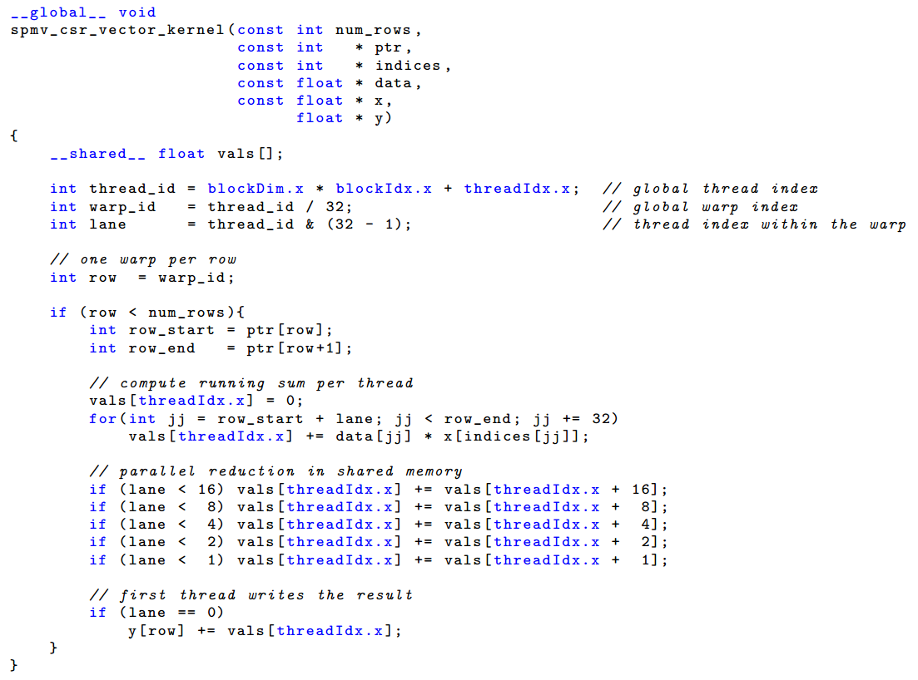
CSR vector kernel
Thread i in warp multiplies matrix elements i, i+32, i+64, ... by corresponding elements in vector and sums these.
So each warp produces 32 partial sums.
Warp does parallel reduction on partial sums to get sum of row.

Slide 15
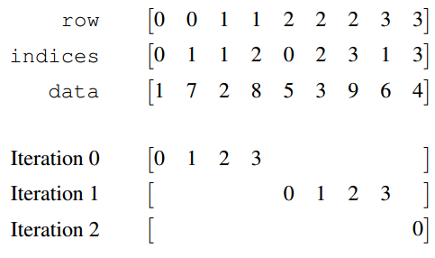
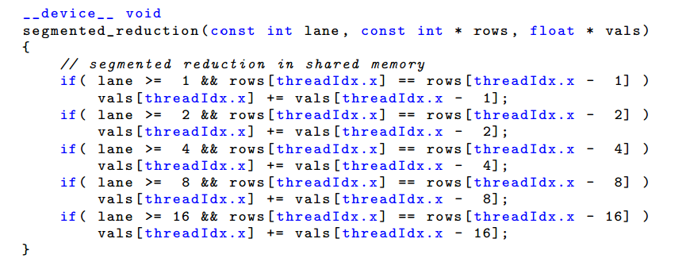
COO kernel
Assign one thread per nonzero.
Perfect load balancing.
Completely coalesced memory accesses.
One warp may span several (short) rows.
Use parallel segmented reduction.
Code above assumes each row spans at most one warp.
For general case see Bell and Garland’s SC2009 paper.

Slide 16
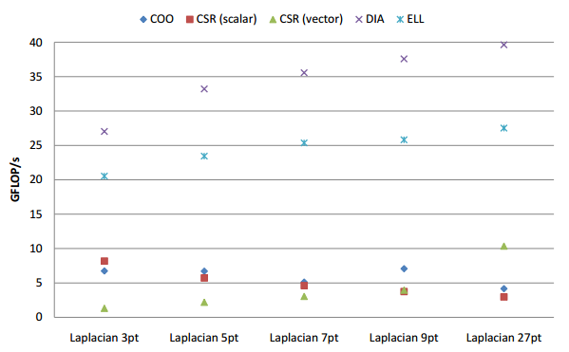
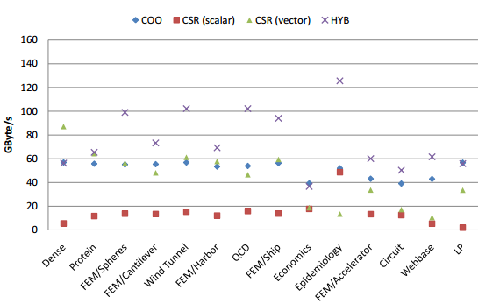
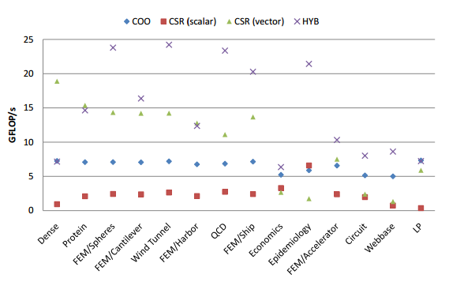
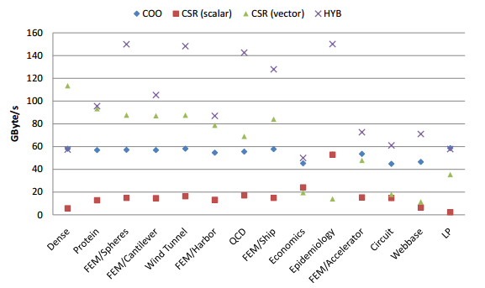
Performance
structured matrices throughput
unstructured matrix bandwidth, no cache
unstructured matrices throughput
unstructured matrix bandwidth, with cache

